Slide 1
Big Mountain Resort Pricing Model
Jiyoon Jung

Slide 2
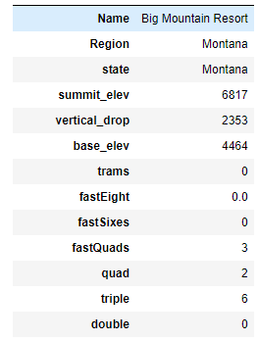
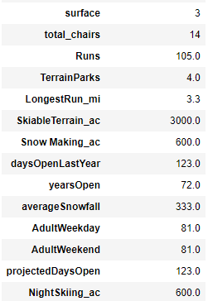
Problem Identification
The objective of this project is to create a pricing model for our ski resort tickets within our target market.
The project aims to develop a predictive model for ticket prices based on various resort facilities and amenities. We will assess the most appealing facility types, where customers are willing to pay more, by comparing ticket prices with other ski resorts that offer similar facilities.
This model will also provide insights for future investment plans in resort facilities.
Big Mountain Resort Statistics (Features)

Slide 3
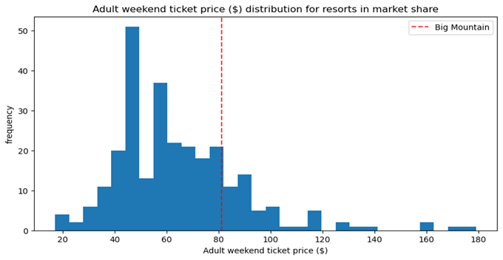
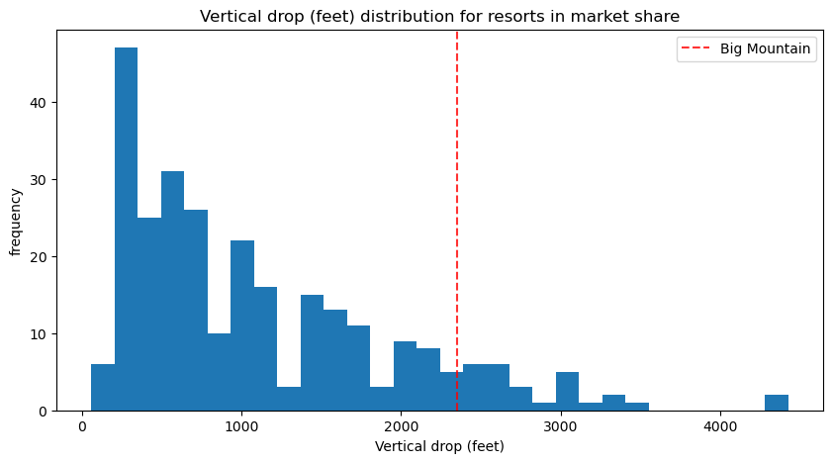
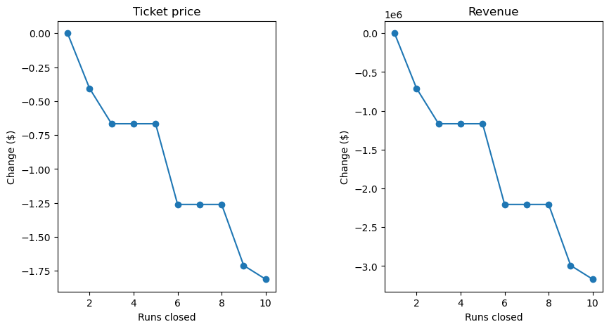
Recommendation and key findings
Increase ticket price: The Adult Weekend ticket price for Big Mountain Resort is currently $81.00. Based on our analysis, even with the expected mean absolute error of $10.37, we recommend that Big Mountain Ski Resort increase its ticket price to $95.74. Our market context analysis considered the following features: vertical drop, snow-making acres, total chairs, fast quads, runs, longest run in miles, trams, and skiable terrain acres.
Facility Investments strategy: Increase the vertical drop by adding a run to a point 150 feet lower down but requiring the installation of an additional chair lift to bring skiers back up, without additional snow making coverage. By implementing Option B, the Big Mountain resort can increase its ticket price by $1.99, resulting in an expected increase in revenue of $3,474,638 over the season. However, in unfavorable market conditions, the business could also consider Option A. This is because the Big Mountain Resort currently has 105 runs and even if 5 runs are closed, the resort will still be in the top 10% of runs in the market. While closing runs could save on operating costs, it would also lead to a $1 million drop in total revenue, as ticket prices would need to be reduced by $0.75.
New Pricing

Slide 4
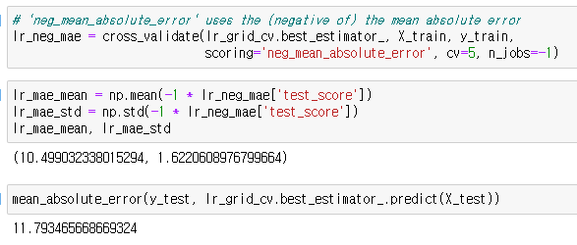




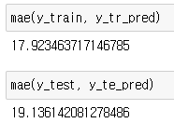
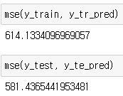

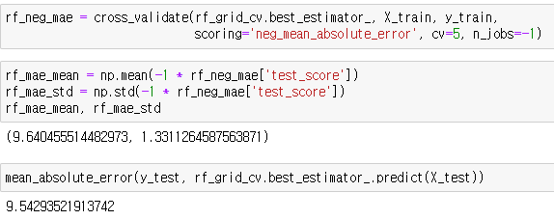
Modeling results and analysis
Select the best model metrics & model
Linear Model
R-squared
Mean absolute error
Mean Squared Error
Cross-validation check CV_Result on 'test score'
np.mean(cv_scores), np.std(cv_scores): (0.6327128053007867, 0.09502487849877693)
Test score(split): array([0.63760862, 0.72831381, 0.74443537, 0.5487915 , 0.50441472])
Random Forest Model

Slide 5
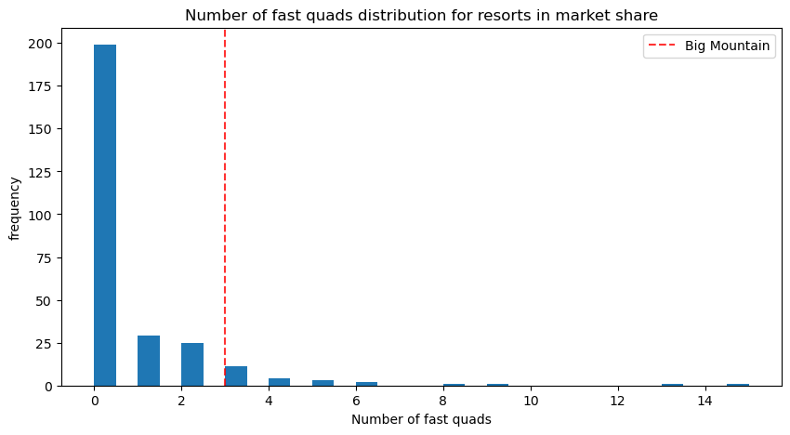
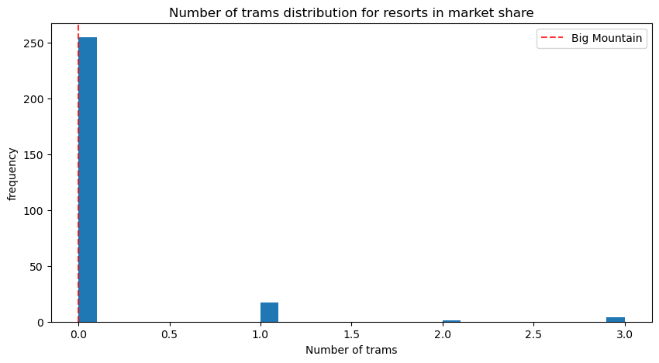
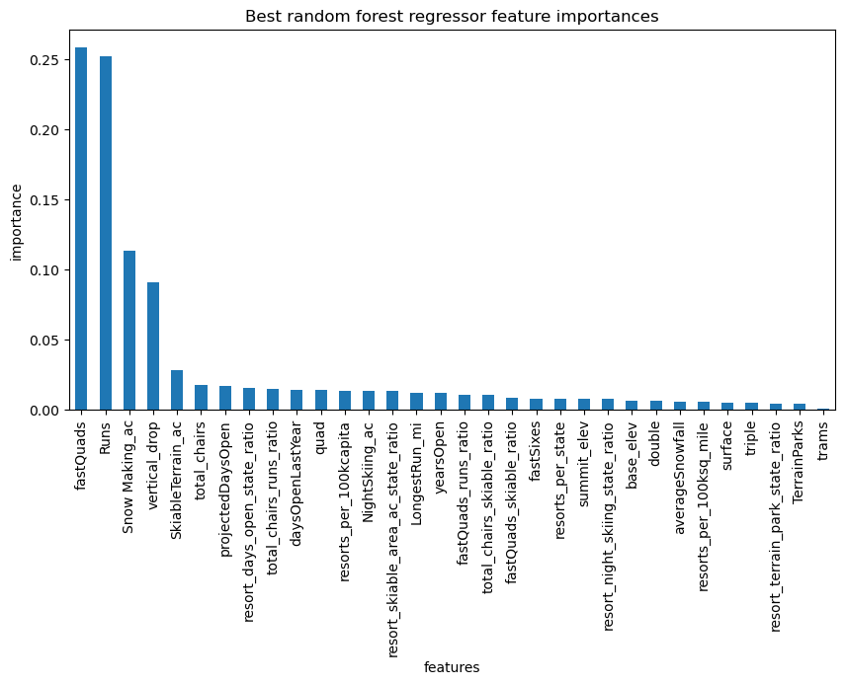
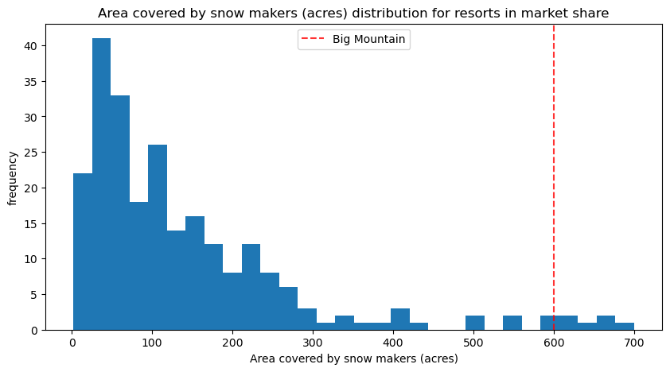
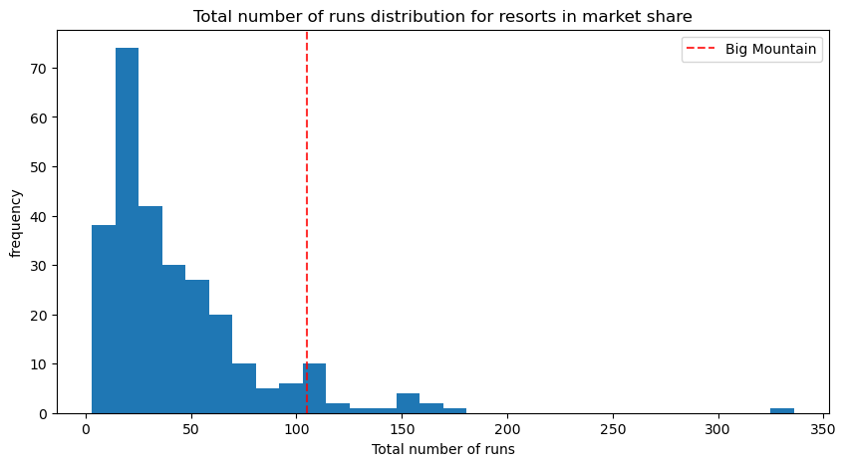
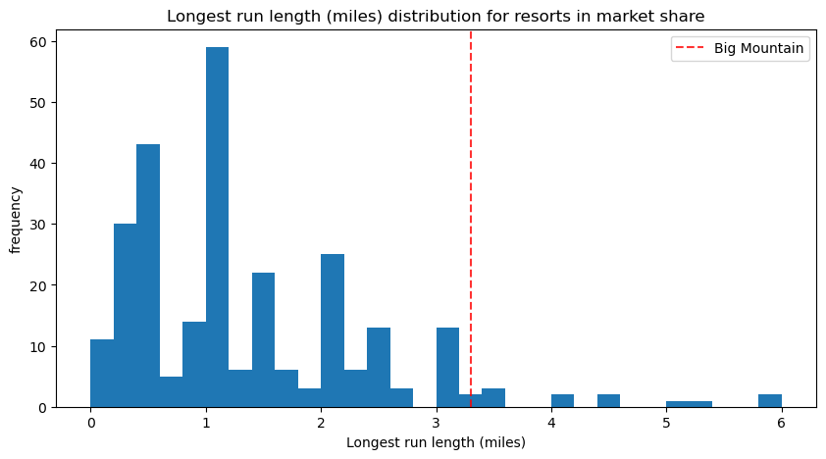
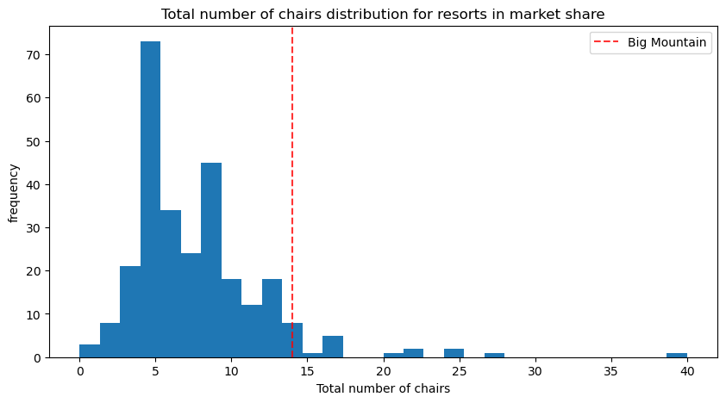
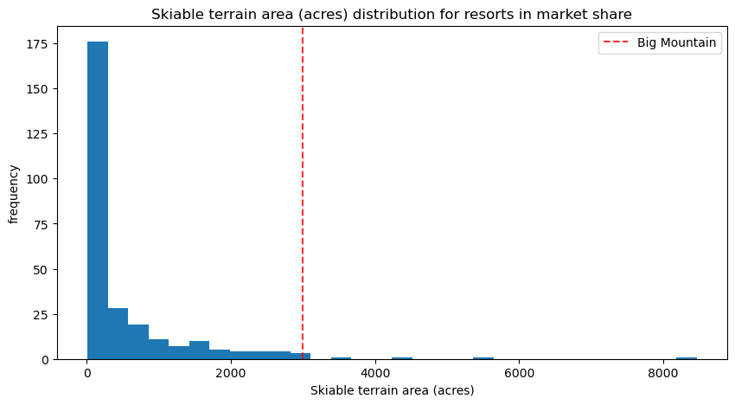
Modeling results and analysis
vertical_drop
Fast Quads
Find the best random regressor features By assigning the feature_importances’ attribute imps = rf_grid_cv.best_estimator_.named_steps. randomforestregressor.feature_importances_
Trams
Snow Making area
Runs
Long Runs
Total number of chairs
Skiable Area

Slide 6
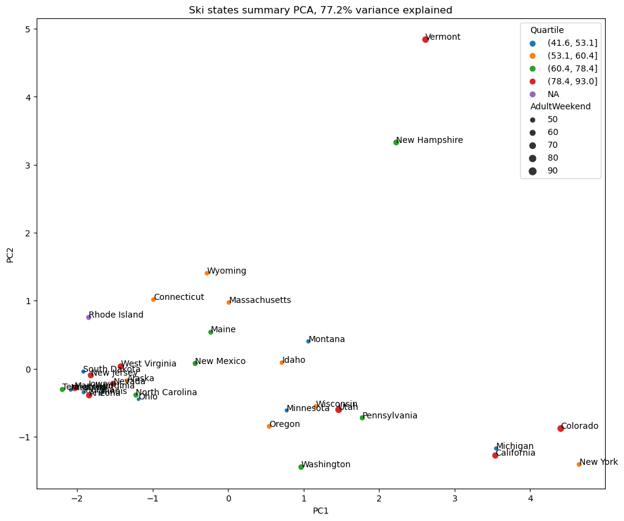
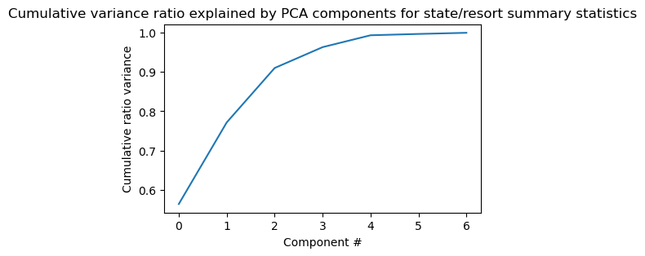
Modeling results and analysis
Fit the PCA transformation
The first two components seem to account for over 75% of the variance, and the first four for over 95%.

Slide 7
Summary and Conclusions
Ticket Pricing Strategy:
Big Mountain Resort currently charges $81 for a ticket, while the model suggests a market-supported ticket price of $95.74, considering features such as vertical drop, snow making acreage, total chairs, fast quads, runs, the longest run in miles, trams, and skiable terrain acreage. This analysis indicates that Big Mountain's facilities and offerings could justify an increase in ticket price by approximately $14.74 to align with market value.
Future Improvements Recommendation:
Among the options considered for future investments, Option B emerges as the most favorable, promising an additional revenue of $3,474,638 over the season for a $1.99 increase in the ticket price. This option leverages Big Mountain's current strengths without significantly altering its operational dynamics. While Options 3 and 4 didn't show a notable difference from Option 2, Option A presents a conservative alternative that could be considered under less favorable market conditions.
Testing and Progressing with Run Closures:
If considering run closures as part of a cost-saving measure, the business could test the impact by selectively closing runs during non-peak times to assess visitor reactions and operational savings. Gathering customer feedback during this period could inform whether a permanent closure of certain runs would be acceptable to visitors and financially advantageous. Moreover, leveraging social media and customer surveys could provide insights into customer preferences, guiding future improvement decisions.

